Slide 1
PRESENTATION ON HOUSING PROJECT
Presented By
Dipesh Ramesh Limaje

Slide 2
Problem Statement
The problem statement for this housing project is to predict the sale price to develop a predictive model for the sale price of houses based on certain features such as the size of the house, types of garages, types of exterior, type of roads, location, and other features that may affect the sale price of a house. The model must be able to accurately predict the sale price of a house based on these features so that potential buyers and sellers can get an idea of the expected sale price of a house.

Slide 3
EDA Steps
1) Check data shape(Num. of Rows, Num. of Columns)
(1168,81)
So there are 1168 Rows and 81 Columns.
2) Check each data type of columns and missing Values
So from data.info, we get all the information related to data types, and after observing all data types they are all ok.
And after observing all values from columns there are missing values, so we treat the missing values by mean for continuous data and mode for the categorical data.
3) Change the data types
After all observations, the data looks good we don't need to change any of the data types.

Slide 4
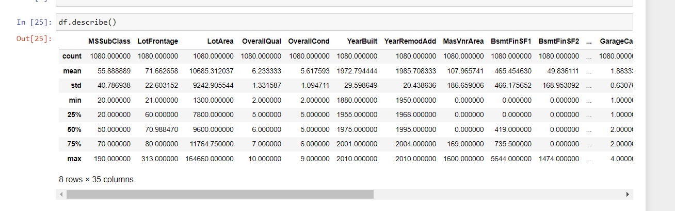
4) Summary Statistics
From this, we can see the data distribution that you have for each and determine whether there are outliers or not.
5) Check Duplicate values
Here we don't have any specific unique ID so here we can't remove the duplicate, and if try to remove it the data will become useless.

Slide 5
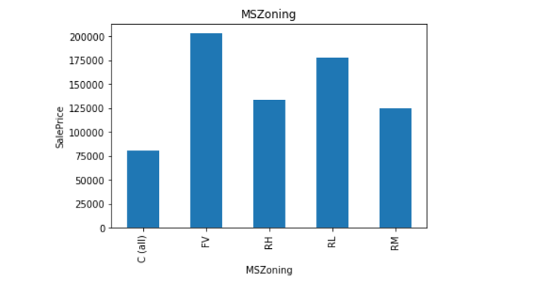
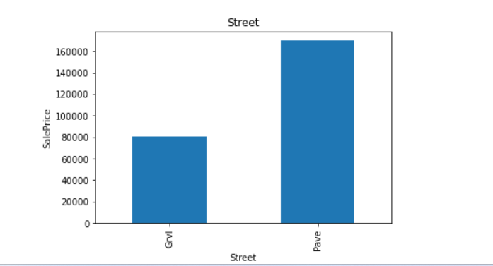
So according to the MSZoning FV (Floating Village Residential) has the highest selling price followed by RL (Residential Low Density) and C (Commercial) has a low selling price
So According to the street graph, we have two types of roads Gravel and Paved so the road type pave has a high sale price as compared to gravel road type

Slide 6
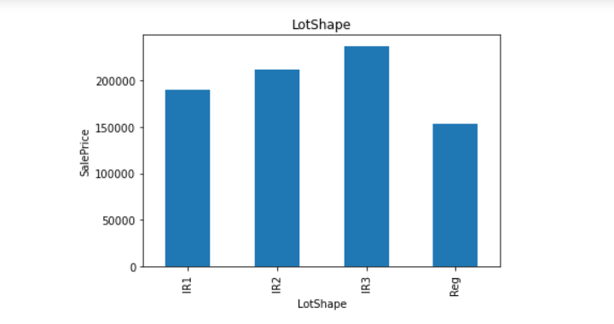
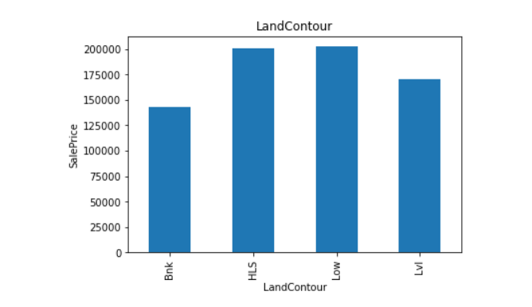
So According to the Lotshape, The IR3 (Irregular) type has a high sale price followed by IR2(Moderately Irregular) and IR1 (Slightly irregular) and the least sale price is for REG (Regular) shape lot shape.
So According to the LandCountour HLS(Hillside - Significant slope from side to side) and LOW (Depression) have equal and higher sale prices as compared to other Landcontour followed by LVL (Near Flat/Level) types of the LandContour.

Slide 7
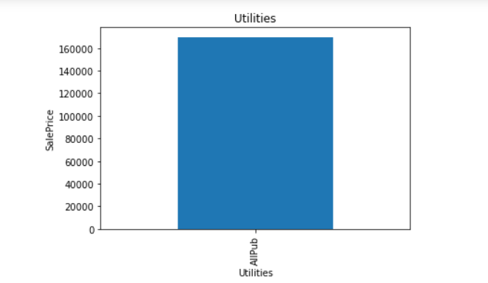
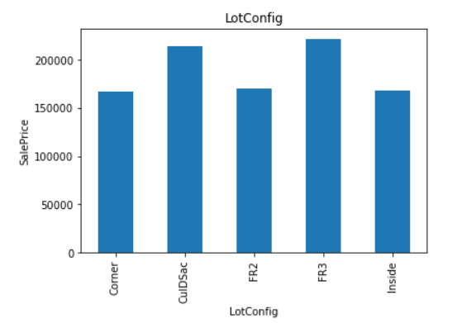
So According to the data, we have 4 types of utilities that are ALLPUB (All public Utilities (E, G, W,& S)), Nosewr (Electricity, Gas, and Water (Septic Tank)), Nosewa (Electricity and Gas Only), ELO (Electricity only) but according to our Graph we observe all the utilities in the dataset is only using 1 type of utilities that is AllPub (All public Utilities (E, G, W,& S)
So According to the lot configuration, we have 5 types of lot configuration that is Inside (Inside lot), Corner (Corner lot), CulDSac (Cul-de-sac), FR2 (Frontage on 2 sides of the property), FR3 (Frontage on 3 sides of property) and when we compare to the sale price we observe FR3 and CulDSac has Highest Selling price.

Slide 8
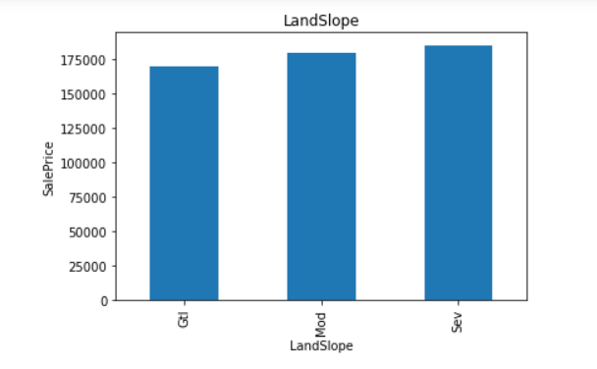
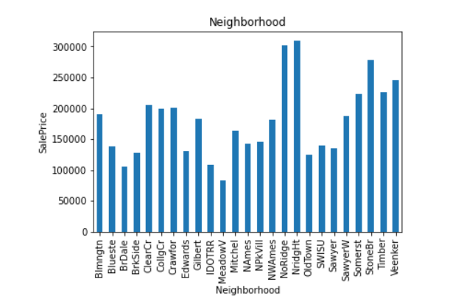
So according to the Landslope we have 3 types of landscape that is Gtl (Gentle slope), Mod (Moderate Slope), and Sev (Severe Slope), and when we compare to the sale price we observe Landslope which has the highest salingprice is Sev followed by Mod and Gtl.
So according to the Neighbourhood, there are 25 unique types in the neighborhood and we observe NridgHt (Northridge Heights), and NWAmes (Northwest Ames) these 2 neighborhood has the highest selling price, and MeadowV (Meadow Village) has a low selling price.

Slide 9
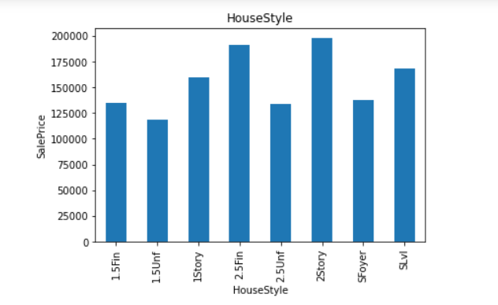
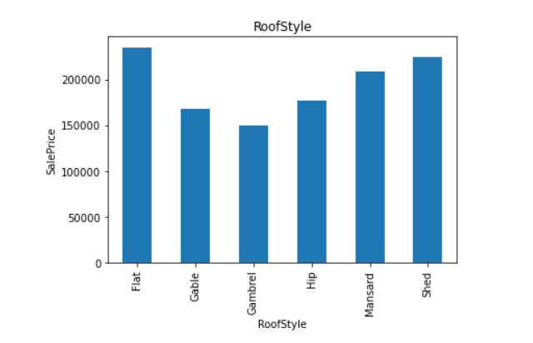
So according to the house style, we have 8 different house styles and in that 2Story and 2.5Fin (Two and one-half story: 2nd level finished) has the highest-selling Price as compared to other house styles
So according to the Roofstyle, we have 6 different roof style and we observe Flat and Shed has the highest selling price as compared to the other roof style.

Slide 10
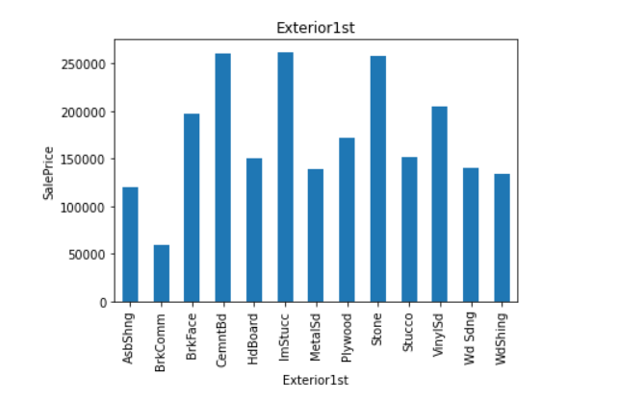
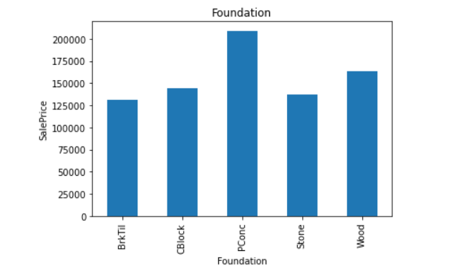
So according to the Exterior covering of the house, we have 17 different types of Exterior covering house but the most popular and highest selling are CemntBd (Cement Board), ImStucc (Imitation Stucco), and Stone (Stone).
So according to the type of Foundation use we have 5 different types of foundation and the highest selling is the PConc (Poured Concrete) type of foundation.

Slide 11
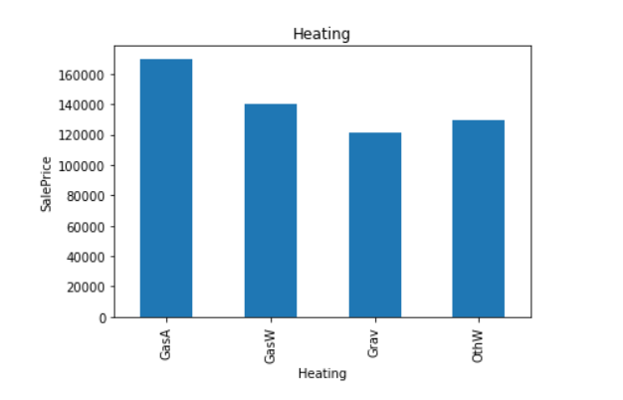
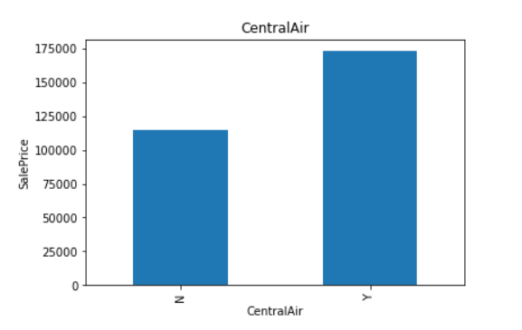
So According to the Heating, we have 5 different types of heating but the most selling type of heating is GasA (Gas forced warm air furnace).
So According to the CentrailAir which house that has Central is the highest selling as compared to the house which does not have central air.

Slide 12
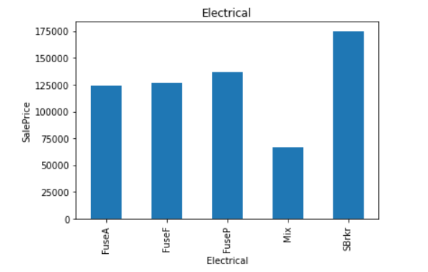
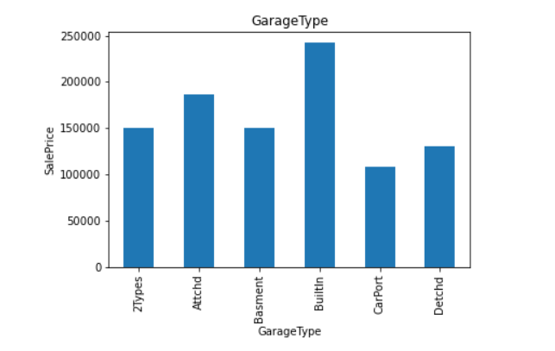
So according to the Electrical System installed in every property the electrical system with SBrkr (Standard Circuit Breakers & Romex) has the highest selling price
So according to the GarageType, we have 6 different types of the garage but BuiltIn Built-In (The garage part of the house - typically has room above the garage) has the highest selling price.

Slide 13
The Set Of Assumptions Related To The Problem Under Consideration
1] After Filling in all the null values by mean and mode, I dropped some nan values which I fill it is unnecessary, and Dropped some features that have missing values of more than 50%.
2] For this particular problem I have assumed that the Maximum VIF should be 10, if any of the features has a VIF which is greater than 10 we should drop that feature.

Slide 14
Steps
1) First we identify null values and applied values by using simple imputer
2) Then I identified duplicates and I have dropped duplicates
3) Performed EDA and wrote all observations for each graph
4) Then i dropped unnecessary columns
5) Then applied a label encoder to the categorical columns
6) Then also plotted the Distribution plot and regression plot
7) Then plotted boxplot to remove outliers
8) Then treated outliers with the Z-score method
9) Then scaled data and Also check for VIF
10) Then find the co-relation between feature and label by the CORR method
11) Then selected the top features by busing Selectkbest technique
12) Then created 4 models that is Gradient Boosting Regressor, Random Forest Regressor , linear Regressor model, Ada Boosting regressor model with hyperparameter tuning for all 4 models and also Cross-validations
13) At last I selected the best model according to their CV score and Training(R2) and testing score(R2)

Slide 15
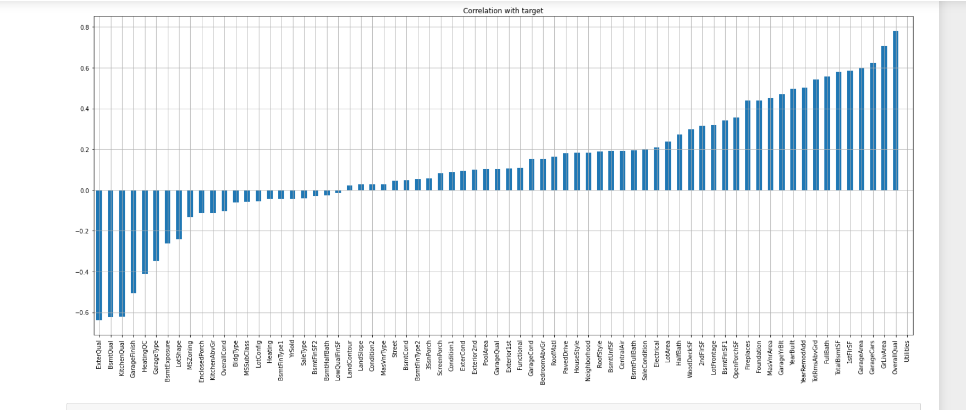
These are all the features that are positively co-related to the label and Negatively Co-related to the Label

Slide 16
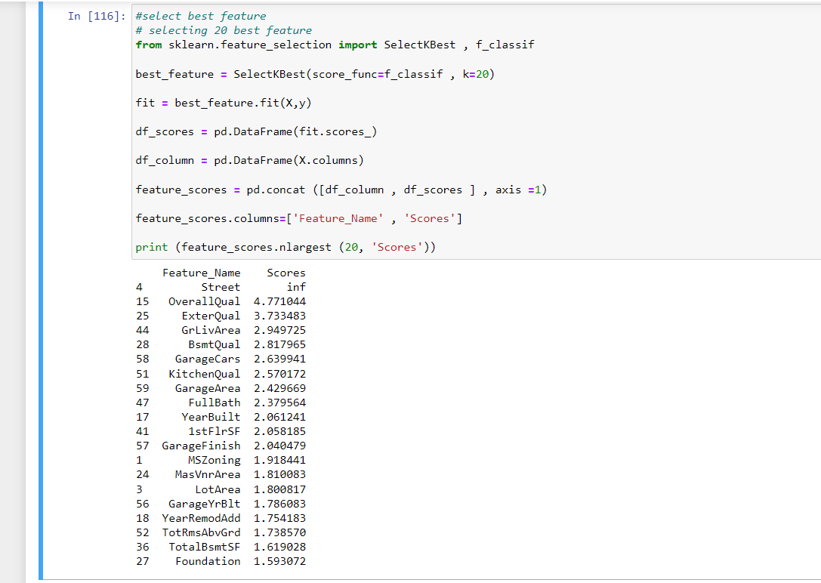
Selection Of top 20 features which will help more to predict our label
The top 20 Feature According to SelectKbest is Street, OverallQual, ExterQual, GrLivArea, BsmtQual, GarageCars, KitchenQual, GarageArea, FullBath, YearBuilt,1stFlrSF, GarageFinish, MSZoning, MasVnrArea, LotArea, GarageYrBlt, YearRemodAdd, TotRmsAbvGrd, TotalBsmtSF, Foundation.

Slide 17
Testing of Identified Approaches (Algorithms)
LR (Linear Regression Model)
GBDT (Gradient Boosting Regressor Model)
RF (Random Forest Regressor Model)
ADA (AdaBoost Regressor Model)

Slide 18
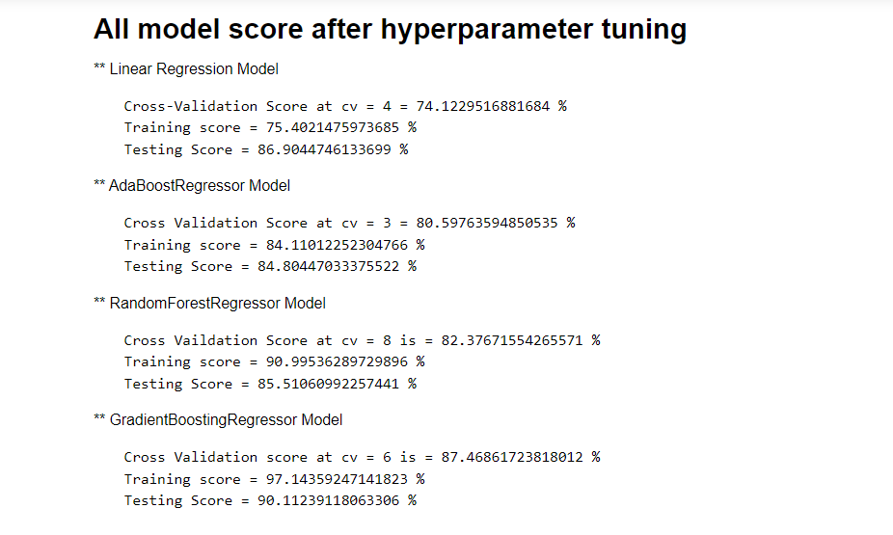
These are 4 Models Which I selected to predict the Sales of the House and after hyperparameter tuning, we Find that Gradient Boosting Regressor is the best-suited model and so selecting Gradient Boosting Regressor Model.

Slide 19
CONCLUSION
So from above all 4 model scores, we observe Gradient Boosting Regressor Model is best Suited model for this particular model as the training score is 97.14359247141823 % and the testing score is 90.11239118063306 % and the Cross-Validation score at cv = 6 is = 87.46861723818012 % thus saving this model and we will use this model to prediction on the test dataset.

Slide 20
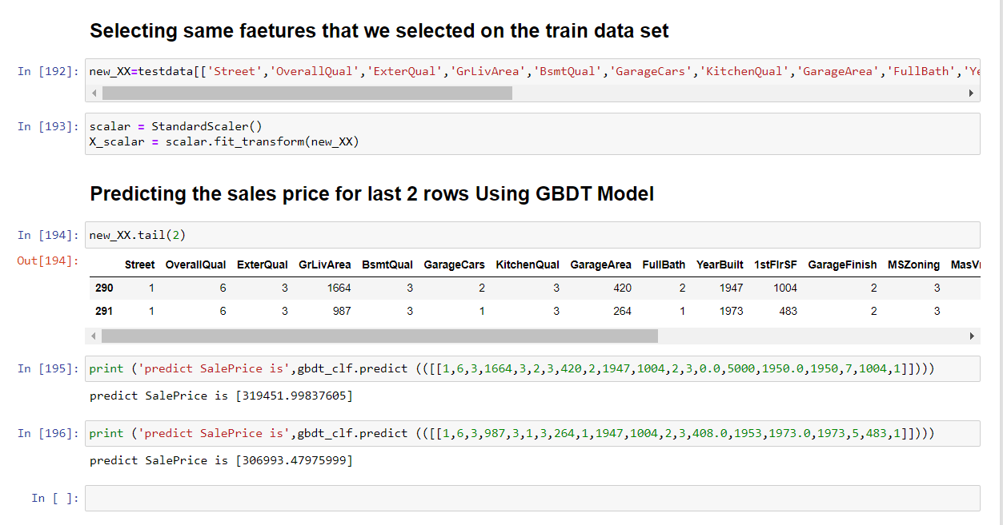
After Selecting Gradient Boosting Regressor we have Done Prediction On test data but for Last 2 columns

Slide 21
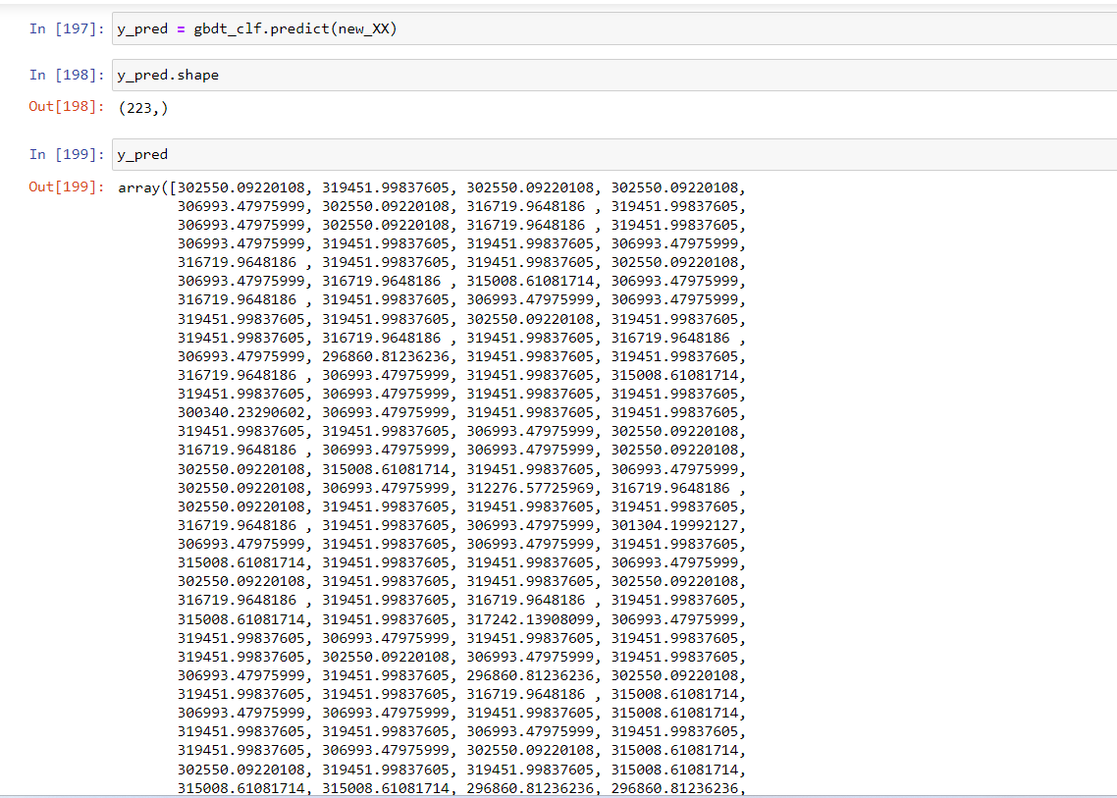
Predicting all the sales prices of the house using Gradient Boosting Regressor Model

Slide 22
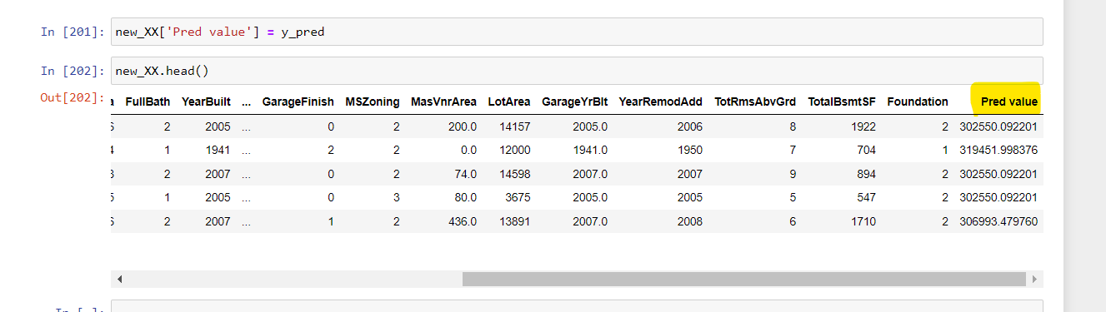
Adding predictive value to the dataset

